Slide 1
Investigating the predictive ability of LSTMs on industrial metal prices
Oliver Boom
Imperial College London

Slide 2
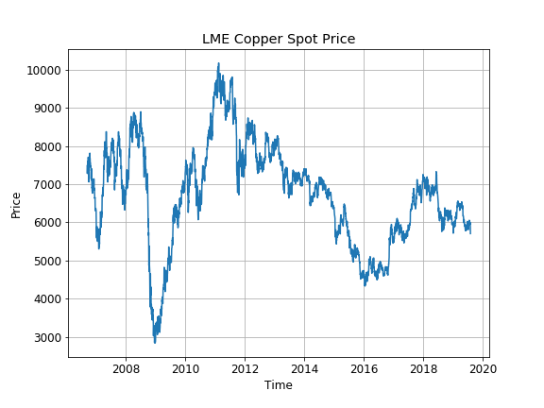
Introduction
Highly desired information
Price forecasting is challenging → Non-linear, volatile, dynamic
Traditional techniques limited → ML can address challenges
Long Short-Term Memory networks (LSTMs) achieve best-in-class results on other sequence predictions problems.
Limited data, exogenous driving factors. Are LSTMs relevant for this context?

Slide 3
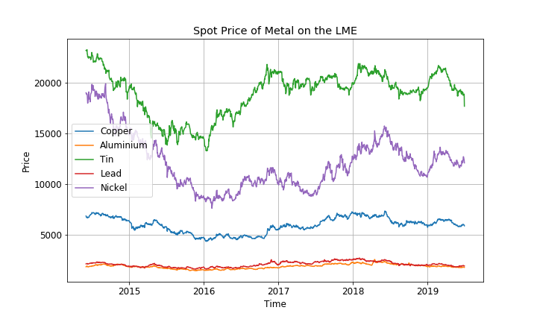
Co-movement of commodities
Common Factor + Idiosyncratic factor
Excessive co-movement of prices
Commodity sub-universe → Industrial Metals

Slide 4
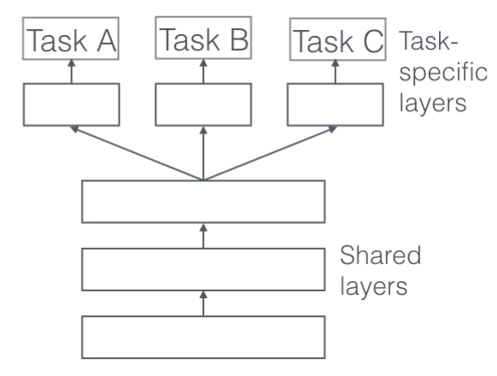
Multi-Task Learning
Multi-Task Learning: A machine learning framework which aims to leverage shared information between a collection of related tasks to improve the predictive performance in all tasks
Individual Tasks → Price of individual metals
Shared layers → Neural network architecture

Slide 5
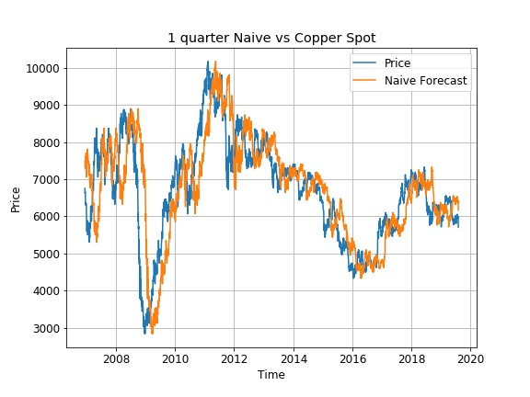
Benchmarks
ARIMA forecast - Decomposes signal into different temporal components
ARIMA
Autoregressive Model → Target depends linearly on it’s own previous values
Moving Average Model → Uses the past errors as explanatory variables in the model
Naïve forecast - Take the price today as the price for the next forecast length

Slide 6
Objectives
Do LSTMs outperform ARIMA and naïve forecasts?
Does Multi-Task Leaning outperform single task?
Does a multi-variate outperform autoregressive?
Foresight is a collection of tools built to investigate the predictive ability of LSTMs on industrial metal prices

Slide 7
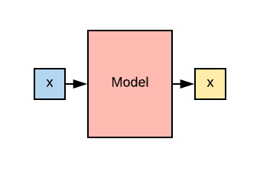
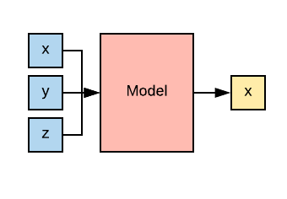
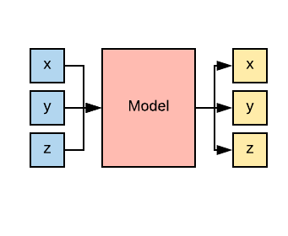
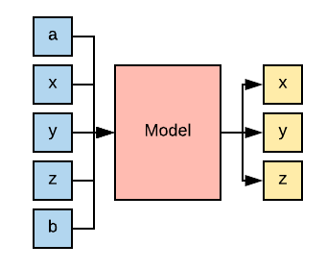
Regression Frameworks
Single Input Single Output
Autoregressive
Multi Input Single Output
Multivariate
Multi Input Multi Output
Autoregressive
Multi Input Multi Output
Multivariate

Slide 8
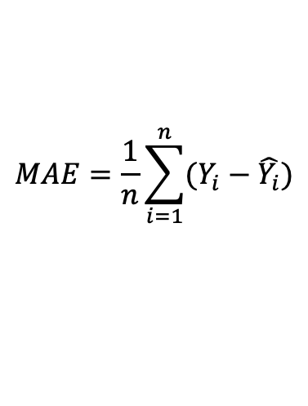
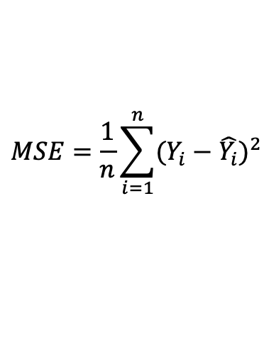
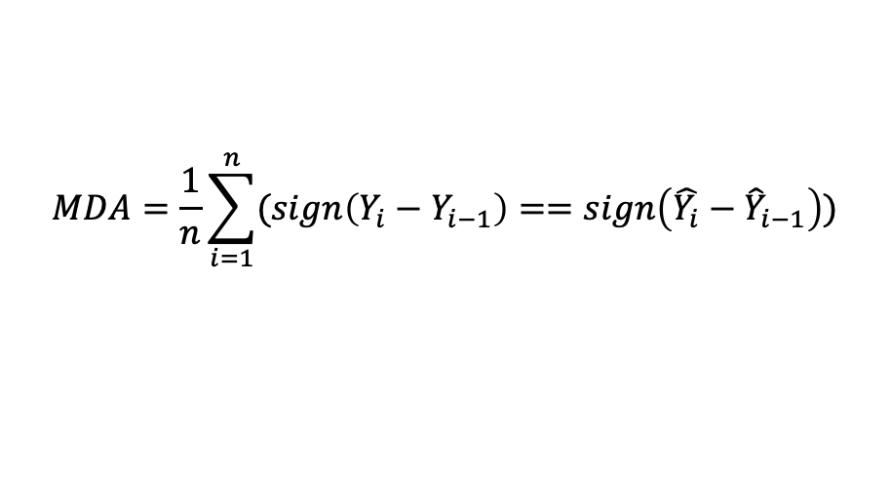
Evaluation Metrics
Forecast lengths: 1 Week, 1 Month, 1 Quarter, ½ year
Commodity Selected: Copper
Multi Task Learning Complex: Copper, Aluminium, Tin, Lead, Nickel
$$MSE=\frac{1}{n}\sum_{i=1}^{n}{{(Y_{i}−\hat{Y_{i}})}^{2}}$$
$$MAE=\frac{1}{n}\sum_{i=1}^{n}{(Y_{i}−\hat{Y_{i}})}$$
Mean Squared Error (MSE) → Higher impact of outliers
Mean Absolute Error (MAE) → More robust to outliers
Mean Directional Accuracy (MDA)
$$MDA=\frac{1}{n}\sum_{i=1}^{n}{(sign\left(Y_{i}−Y_{i−1}\right)==sign\left(\hat{Y_{i}}−{\hat{Y}}_{i−1}\right))}$$

Slide 9
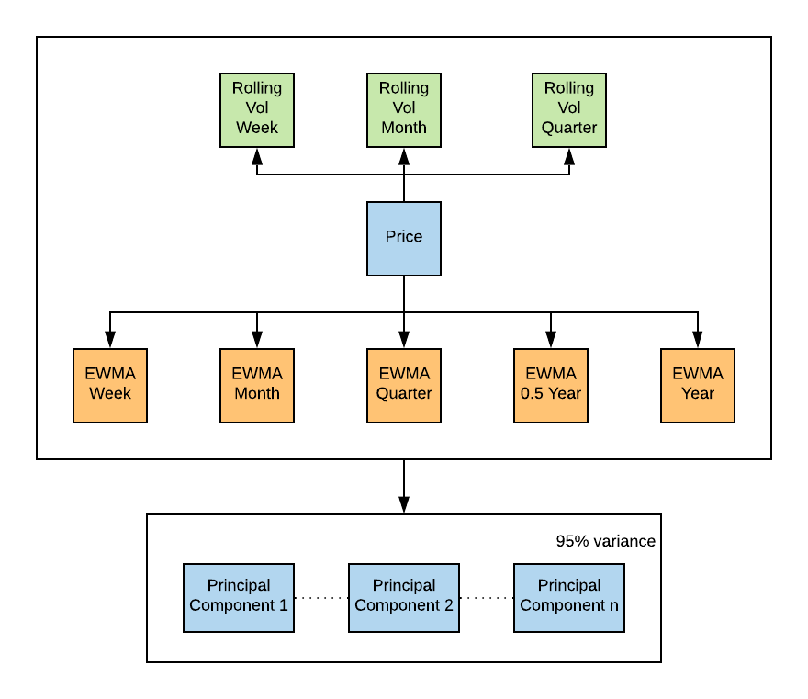
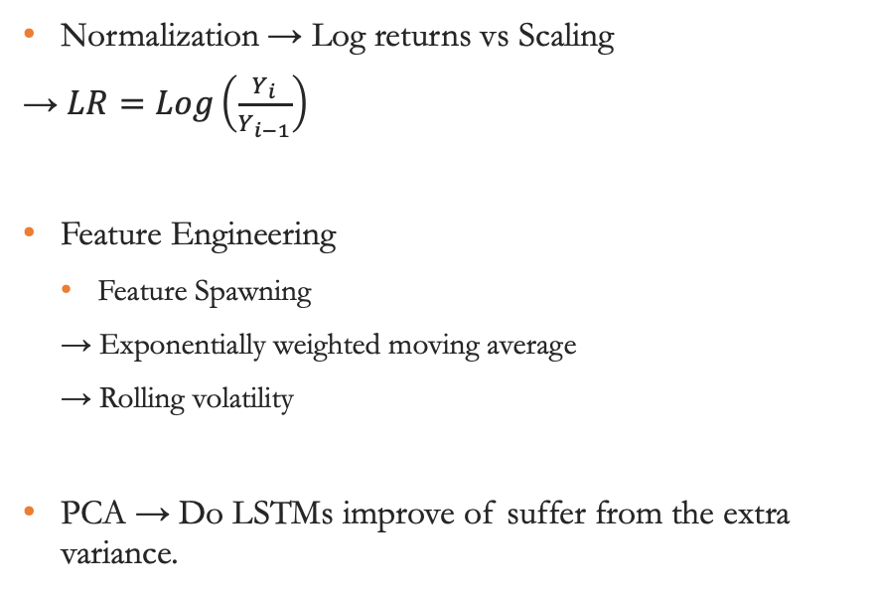
Preprocessing
Normalization → Log returns vs Scaling
→ $LR=Log\left(\frac{Y_{i}}{Y_{i−1}}\right)$
Feature Engineering
Feature Spawning
→ Exponentially weighted moving average
→ Rolling volatility
PCA → Do LSTMs improve of suffer from the extra variance.

Slide 10
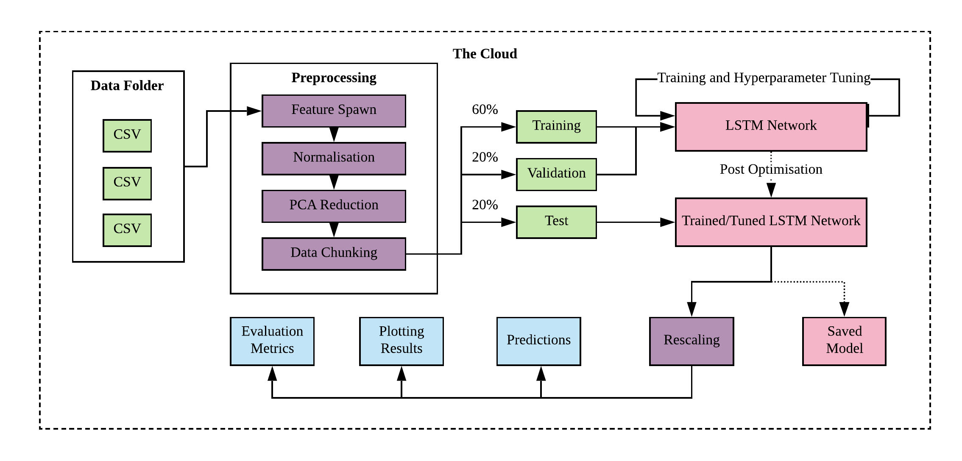
Architecture

Slide 11
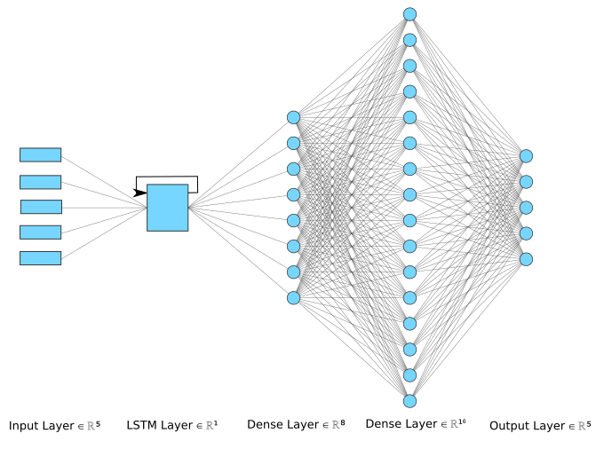
Neural Architecture
Hyperparameter Tuning
→ Begin with simplest model and add complexity
Window size of inputs
→ How far back is relevant for memory

Slide 12
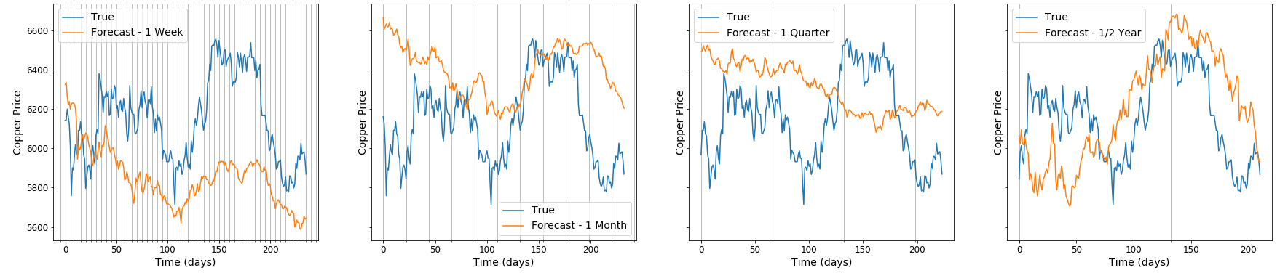
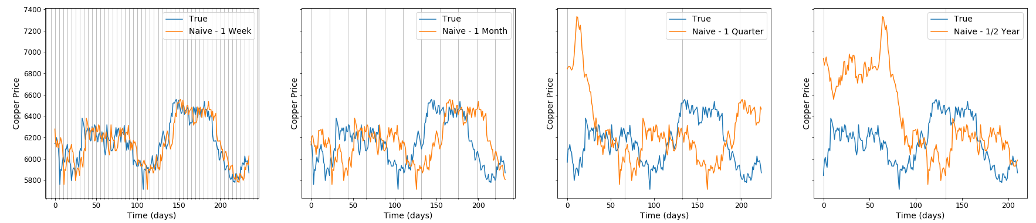
Results
MV MTL LSTM Predictions
Ranked for each metric on each forecast length and summed the ranking number
→ Low score = Highly ranked
Framework | MAE/MSE Only | All
AR MTL | 27 | 36
MV MTL | 24 | 37
Naïve | 17 | 39
ARIMA | 26 | 40
AR | 34 | 46
MV | 40 | 53
Naïve Predictions

Slide 13
What has been learnt?
Across all metrics LSTMs outperformed benchmarks, but can be framed in different ways (regression only, cumulative sum etc.)
Multi task is effective over longer time frames
Multivariate outperforms autoregressive but only in the multi task case.
Feature spawn not effective for LSTMs but PCA is
Scaling shown to be more effective than the naturally transforming log returns
Optimal window size:
Short term (1 week-1 month) → ½ a year
Long term (1 month to half a year) → 1 year

Slide 14
Questions

